Slide 1
Employee Data Analysis using Excel
STUDENT NAME: MEERA.H
REGISTER NO: 122202043/27537AEE5B8618B8DB749380F94B6DA2
DEPARTMENT: B.COM CORPORATE SECRETARYSHIP
COLLEGE: ANNA ADARSH COLLEGE FOR WOMEN

Slide 2
PROJECT TITLE
Employee Performance Analysis using Excel

Slide 3


AGENDA
Problem Statement
Project Overview
End Users
Our Solution and Proposition
Dataset Description
Modelling Approach
Results and Discussion
Conclusion
3/21/2024 Annual Review

Slide 4

PROBLEM STATEMENT
Performance analysis for employees is used to evaluate their effectiveness, identify strengths and areas for improvement, set goals, provide feedback, and support career development.

Slide 5

PROJECT OVERVIEW
Analyzing employee performance by evaluating factors such as gender, performance scores, and ratings, among others.

Slide 6

WHO ARE THE END USERS?
•Employee,
•Employers,
•Owners,
•Managers,
•Shareholders etc.,

Slide 7

OUR SOLUTION AND ITS VALUE PROPOSITION
1. Conditional formatting – Missing
2. Filter -Remove
3. Formula – Performance
4. Pivot – Summary
5. Graph – Data visualization

Slide 8
Dataset Description
Employee dataset – dashboard
26 – features
9 – features
Employee id – numerical
Name – text
Employee type
Performance level
Gender –male, female
Employee Rating – numerical

Slide 9

THE "WOW" IN OUR SOLUTION
Performance Level =IFS(Z13>=5,"VERY
HIGH",Z13>=4,"HIGH",Z13>=3,"MED",TRUE,"LOW")
3/21/2024 Annual Review
9

Slide 10
MODELLING
Data collection
• Edunet Dashboard
Feature collection
• Employee id
• Employee name
• Employee status
• Employee performance
Data Cleaning
• Identify the missing value
• Filterout
Performance level
• Employee performance score • Employee current ratings
Summary
• Pivot table
• Slicer
• Cluster chart
10

Slide 11
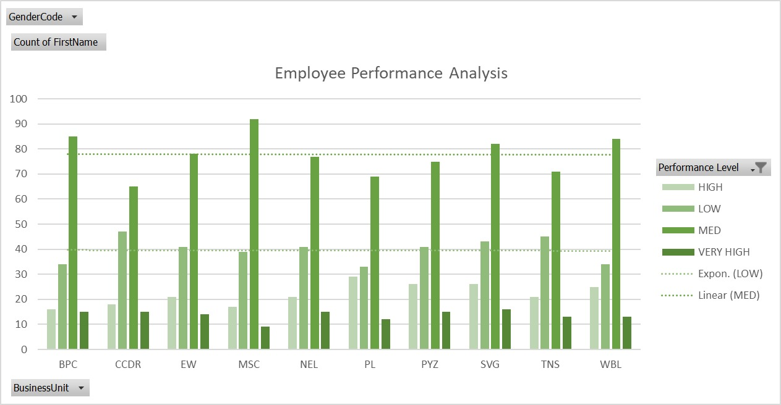
RESULTS
11

Slide 12
conclusion
In this employee performance analysis, employees will receive ratings based on their performance as classified by the analysis.

